Slide 1
Quantum Machine Learning

Slide 2
Outline
Introduction
Quantum Machine Learning (QML) tasks
Applications
Data in QML
Algorithm
Challenges
Quantum Resources

Slide 3
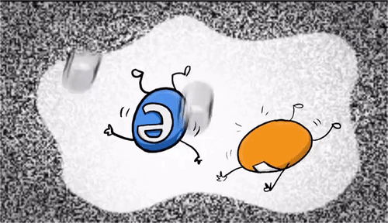

Slide 4
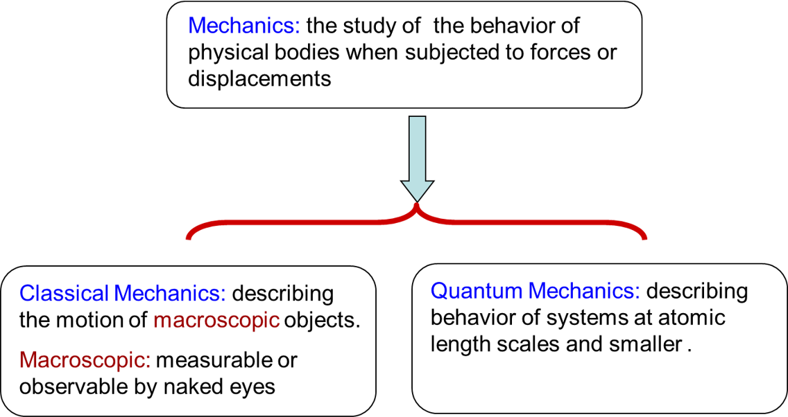
Introduction -- Quantum Mechanics (QM)
QM is established on four fundamental postulates
State Space
Evolution
Measurement
Composite System

Slide 5
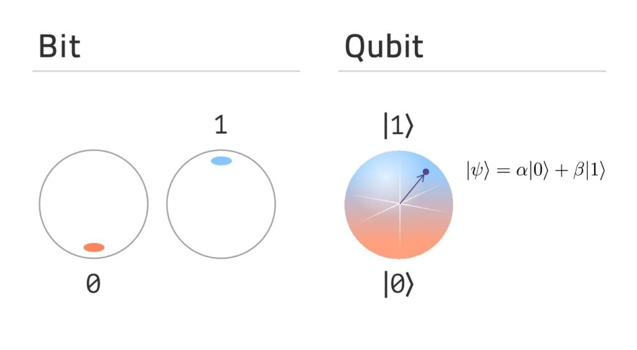
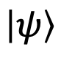
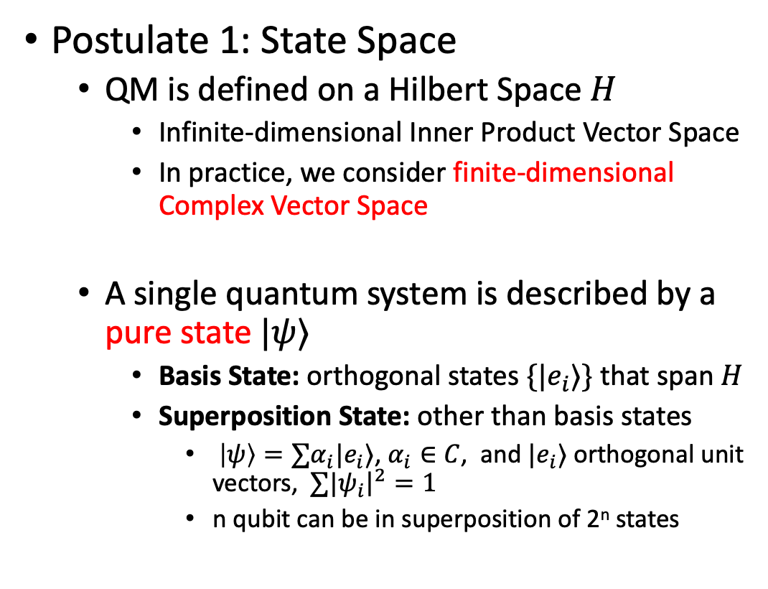
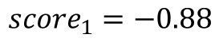
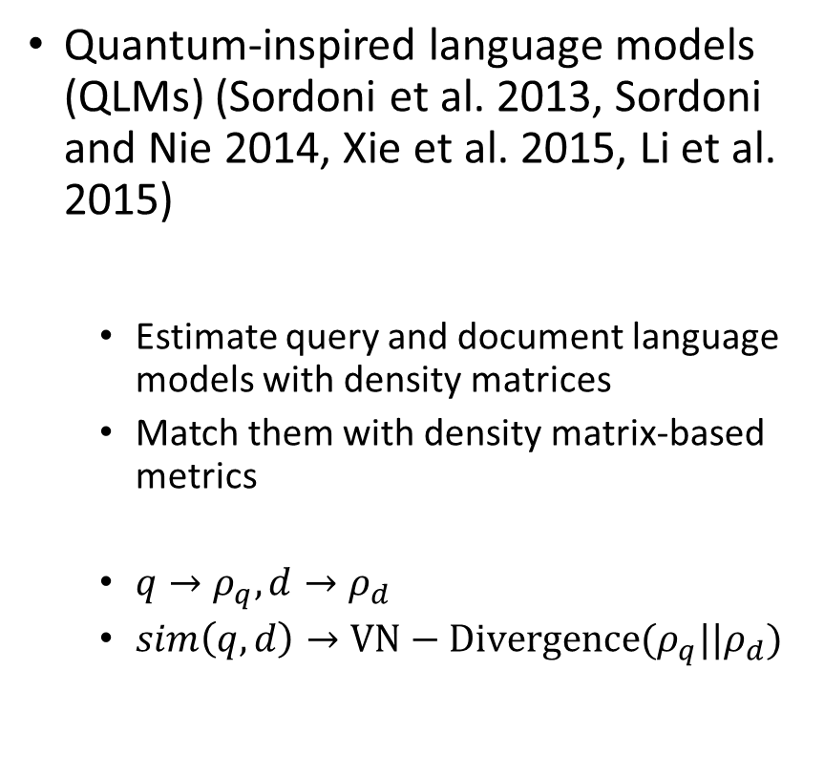
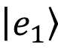
Introduction -- Quantum Mechanics (QM)
Postulate 1: State Space
QM is defined on a Hilbert Space $H$
Infinite-dimensional Inner Product Vector Space
In practice, we consider finite-dimensional Complex Vector Space
A single quantum system is described by a pure state $|ψ〉$
Basis State: orthogonal states $\{{|e}_{i}〉\}$ that span $H$
Superposition State: other than basis states
$|ψ〉=∑α_{i}{|e}_{i}〉$, $α_{i}∈C$, and ${|e}_{i}〉$ orthogonal unit vectors, $∑{|ψ}_{i}{\left.​\right|}^{2}=1$
n qubit can be in superposition of 2^{n} states
$$|e_{2}〉$$
$$H$$
$$|ψ〉$$
$$|e_{1}〉$$

Slide 6
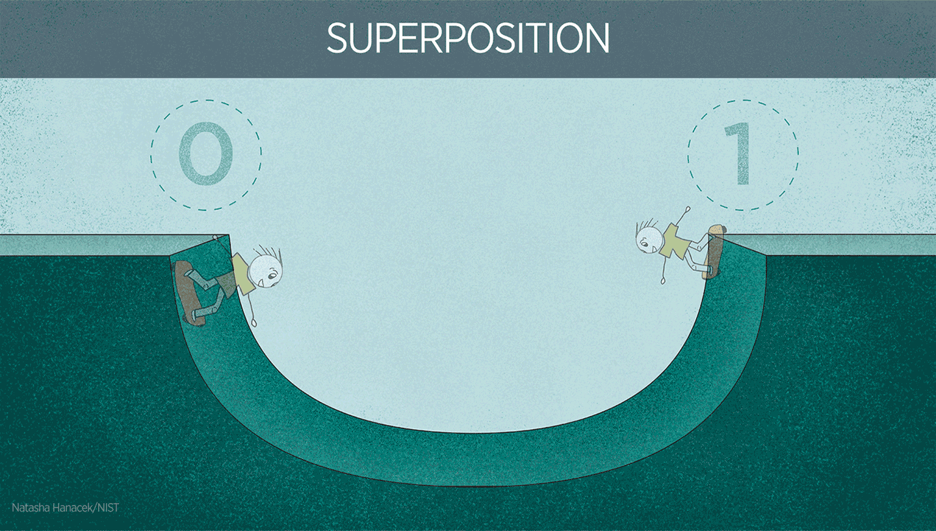
Introduction -- Quantum Mechanics (QM)

Slide 7
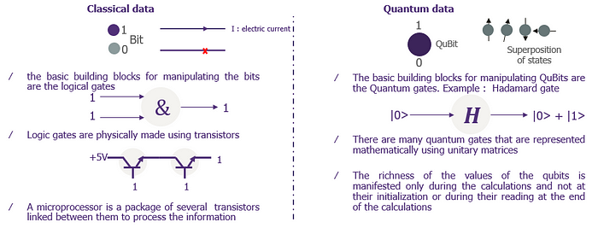
Introduction -- Quantum Mechanics (QM)
Qubits are the basic manipulation elements of information in quantum computers. They oppose the bits of classical computing. With them, we move from a deterministic world to a probabilistic world

Slide 8
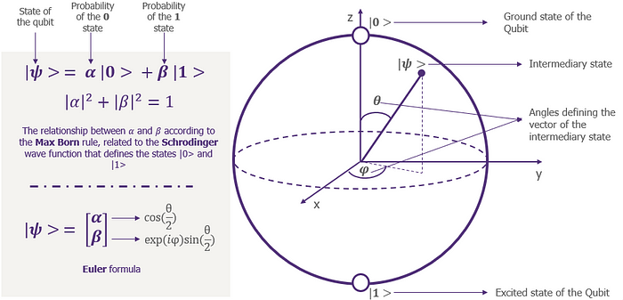
Introduction -- Quantum Mechanics (QM)
Bloch Sphere is the mathematical representation of a qubit. It represents the state of a qubit by a two-dimensional vector with a normal length of one.
Except for the initialization and measurement, it can be in superposition

Slide 9
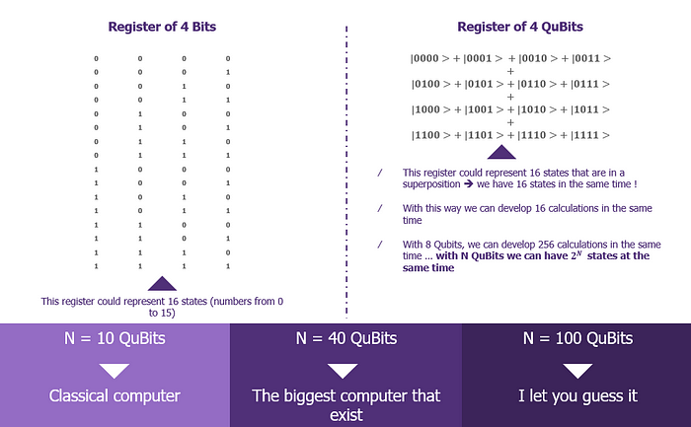
Introduction -- Quantum Mechanics (QM)

Slide 10
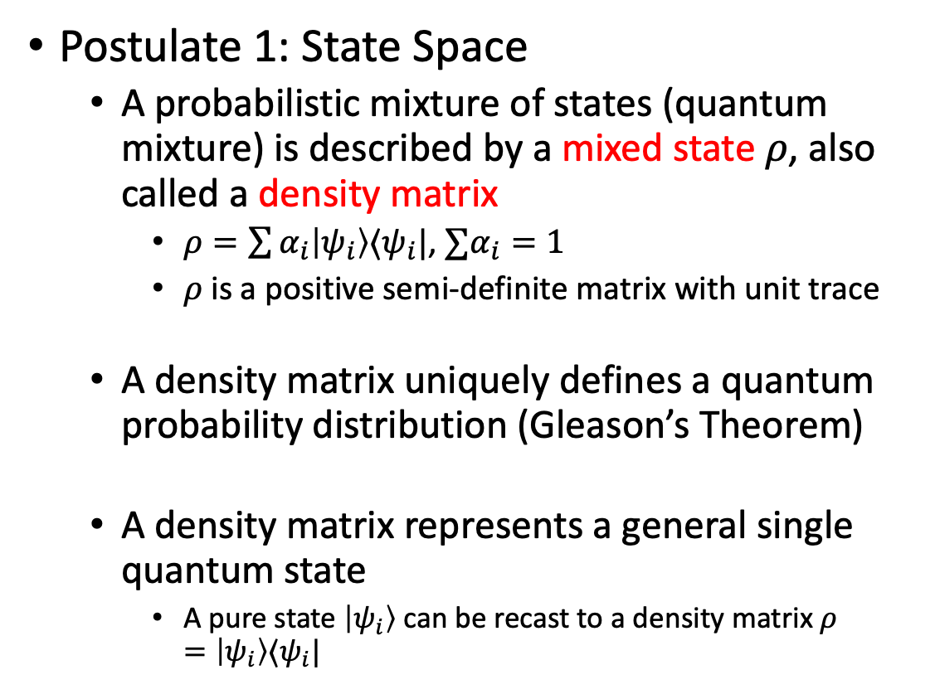
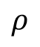
Introduction -- Quantum Mechanics (QM)
Postulate 1: State Space
A probabilistic mixture of states (quantum mixture) is described by a mixed state $ρ$, also called a density matrix
$ρ=\sum{α_{i}|ψ_{i}〉〈ψ_{i}|}$, $∑α_{i}=1$
$ρ$ is a positive semi-definite matrix with unit trace
A density matrix uniquely defines a quantum probability distribution (Gleason’s Theorem)
A density matrix represents a general single quantum state
A pure state $|ψ_{i}〉$ can be recast to a density matrix $ρ=|ψ_{i}〉〈ψ_{i}|$
+
$$|e_{2}〉$$
$$H$$
$$ρ$$
$$|e_{1}〉$$

Slide 11
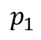
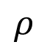
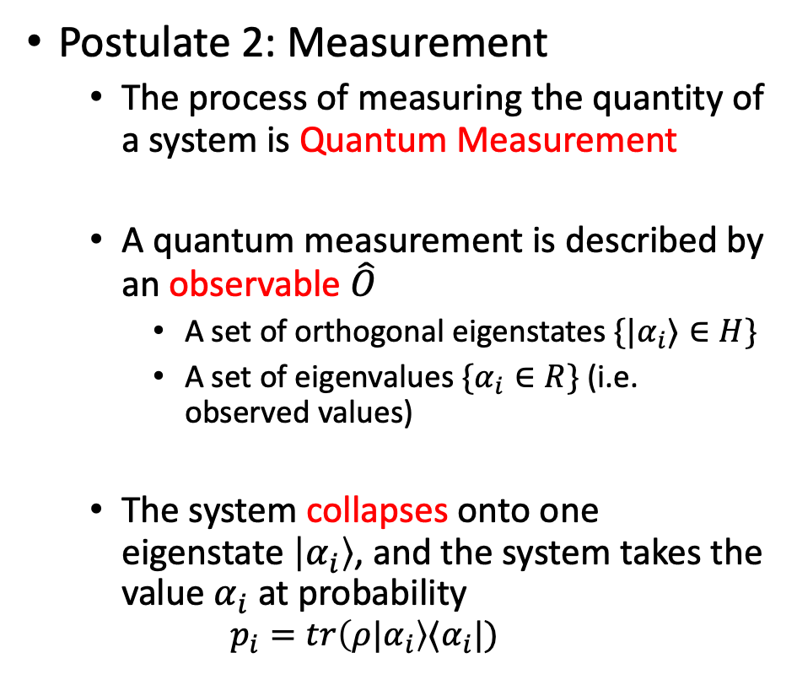
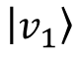
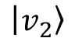
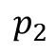
Introduction -- Quantum Mechanics (QM)
Postulate 2: Measurement
The process of measuring the quantity of a system is Quantum Measurement
A quantum measurement is described by an observable $\hat{O}$
A set of orthogonal eigenstates $\{|α_{i}〉∈H\}$
A set of eigenvalues $\{α_{i}∈R\}$ (i.e. observed values)
The system collapses onto one eigenstate $|α_{i}〉$, and the system takes the value $α_{i}$ at probability
$$p_{i}=tr({ρ|α}_{i}〉〈α_{i}|)$$
$$|e_{2}〉$$
$$H$$
$$|v_{1}〉$$
$$ρ$$
$$p_{1}$$
$$|e_{1}〉$$
$$p_{2}$$
$$|v_{2}〉$$

Slide 12
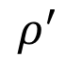
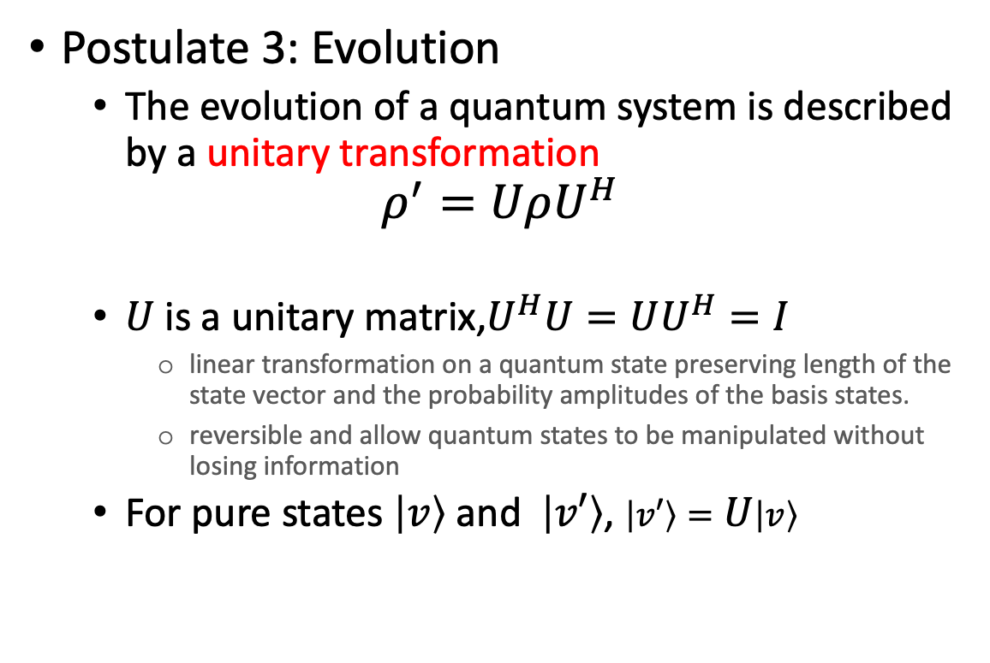
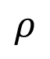
Introduction -- Quantum Mechanics (QM)
Postulate 3: Evolution
The evolution of a quantum system is described by a unitary transformation
$$ρ^{′}=UρU^{H}$$
$U$ is a unitary matrix,$U^{H}U=UU^{H}=I$
linear transformation on a quantum state preserving length of the state vector and the probability amplitudes of the basis states.
reversible and allow quantum states to be manipulated without losing information
For pure states $|v〉$ and $|v′〉$, $|v′〉=U|v〉$
$$|e_{2}〉$$
$$H$$
$$ρ^{′}$$
$$ρ$$
$$|e_{1}〉$$

Slide 13
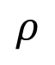
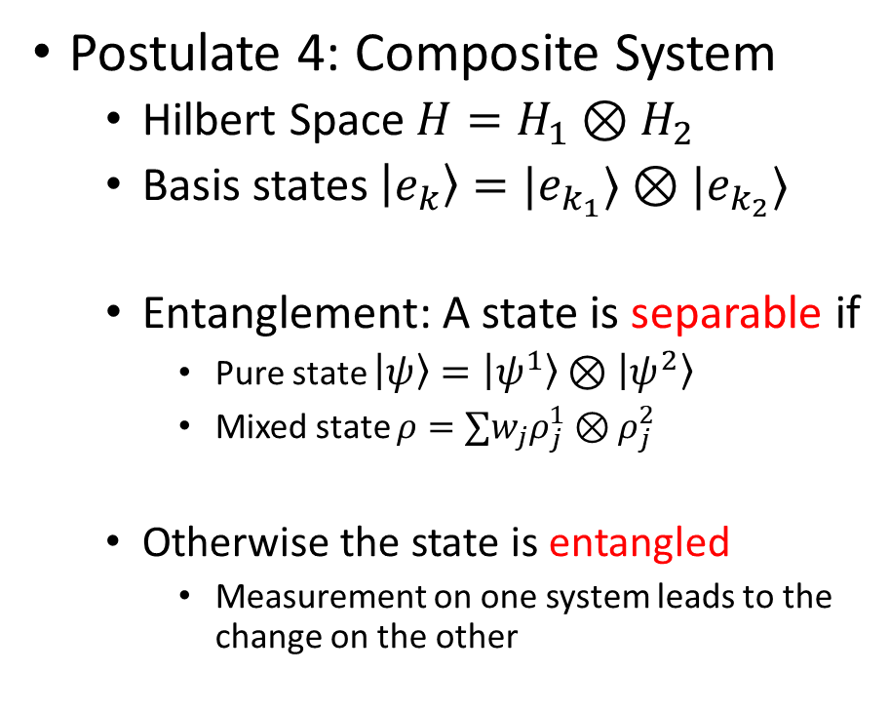
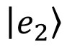
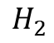
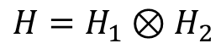
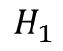
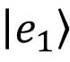
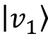
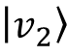
Introduction -- Quantum Mechanics (QM)
$$H_{1}$$
$$H_{2}$$
Postulate 4: Composite System
Hilbert Space $H=H_{1}⊗H_{2}$
Basis states $|e_{k}〉=|e_{k_{1}}〉⊗|e_{k_{2}}〉$
Entanglement: A state is separable if
Pure state $|ψ〉=|ψ^{1}〉⊗|ψ^{2}〉$
Mixed state $ρ=∑w_{j}ρ_{j}^{1}⊗ρ_{j}^{2}$
Otherwise the state is entangled
Measurement on one system leads to the change on the other
$$|e_{2}〉$$
$$|v_{1}〉$$
$$H=H_{1}⊗H_{2}$$
$$ρ$$
$$|e_{1}〉$$
$$|v_{2}〉$$
Notes:
Composite System speaks about multiple quantum systems in combination. The Hilbert Space of a composite system is a tensor product of its component Hilbert Spaces, and each basis state is a tensor product of basis states in component Hilbert Spaces.
The concepts of pure states and mixed states stay the same, but we have the unique property of entanglement that talks about the correlation of two subsystems. When a pure state can be written as a tensor product of individual states in the subsystems, or a density matrix can be written as a linear combination of countable many individual mixed states in tensor product, the state is called a separable state. Otherwise, it is an entangled state. Physically, an entangled state involves non-trivial correlations between two subsystems, such that the measurement on one subsystem leads to the change on the other, even they are a far distance away from each other.

Slide 14
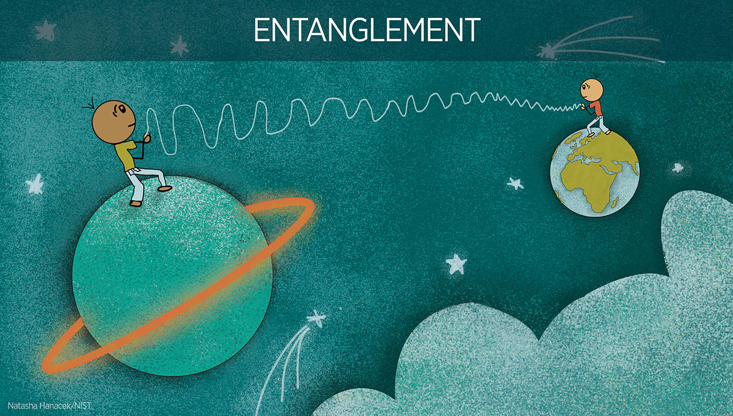
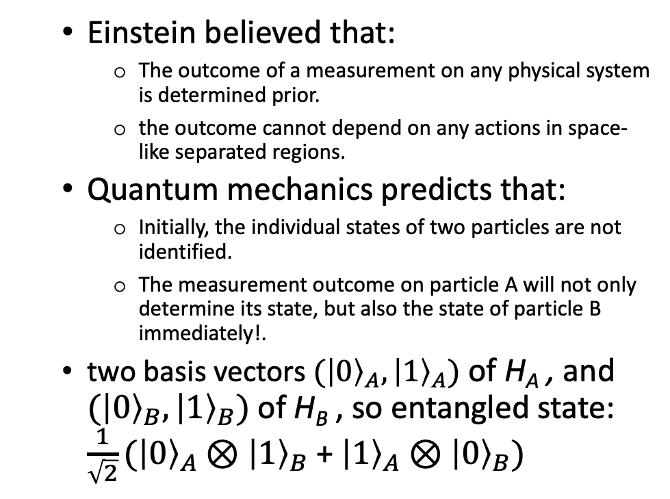
Introduction -- Quantum Mechanics (QM)
Einstein believed that:
The outcome of a measurement on any physical system is determined prior.
the outcome cannot depend on any actions in space-like separated regions.
Quantum mechanics predicts that:
Initially, the individual states of two particles are not identified.
The measurement outcome on particle A will not only determine its state, but also the state of particle B immediately!.
two basis vectors ${(\left|0\right\rangle }_{A},{\left|1\right\rangle }_{A})$ of H_{A} , and ${(\left|0\right\rangle }_{B},{\left|1\right\rangle }_{B})$ of H_{B} , so entangled state: $\frac{1}{\sqrt{2}}({\left|0\right\rangle }_{A}{⊗\left|1\right\rangle }_{B}$ + ${\left|1\right\rangle }_{A}{⊗\left|0\right\rangle }_{B})$

Slide 15
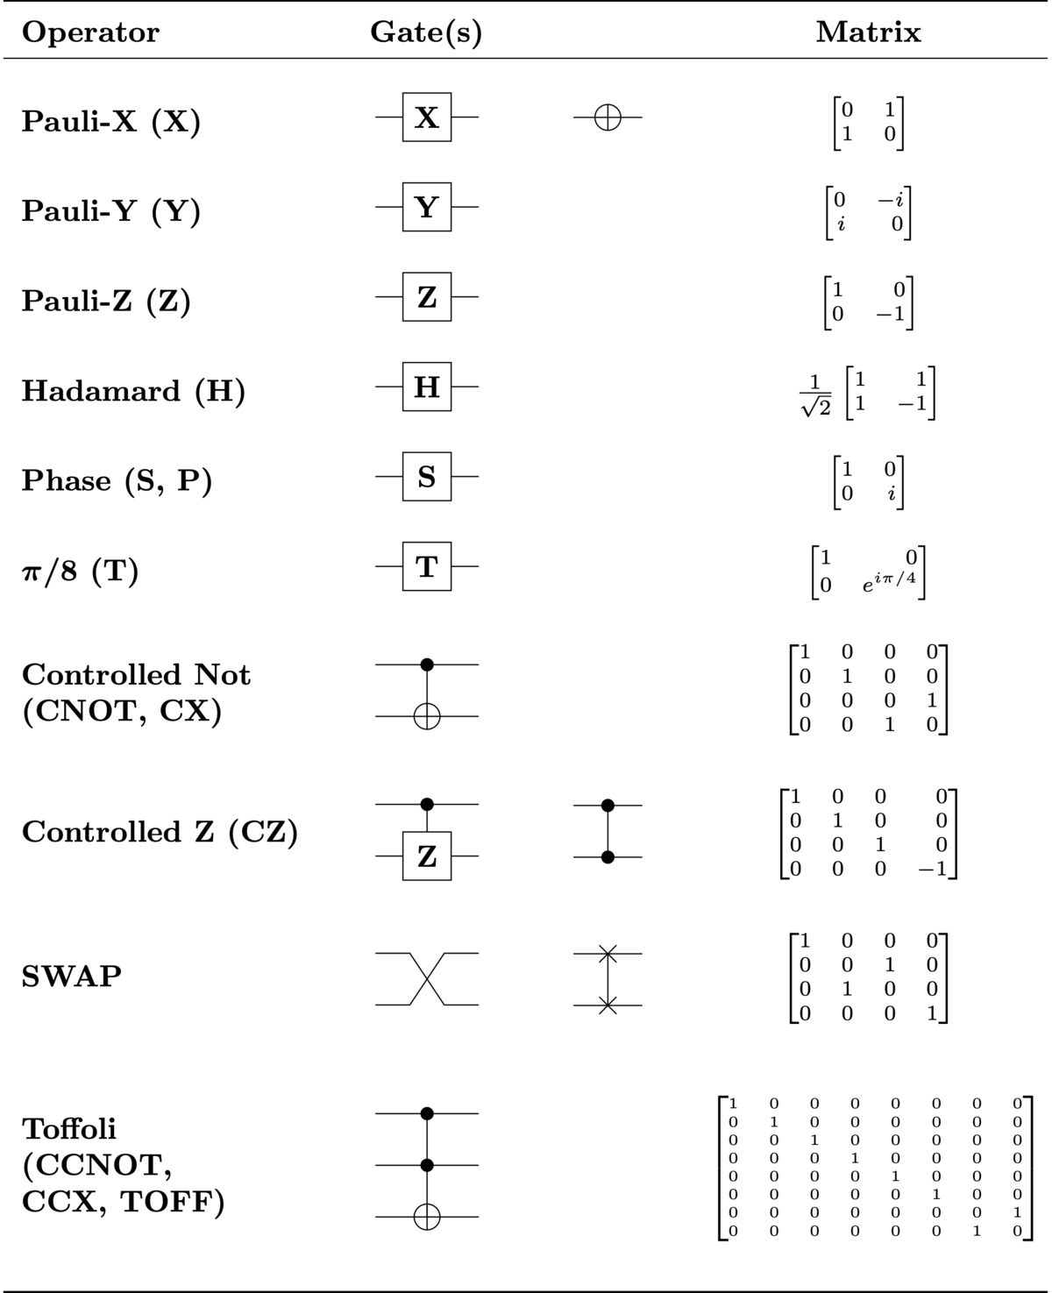
Introduction -- Quantum Mechanics (QM)
Pauli equivalent to NOT gates and rotate the state of qubit around X,Y,Z-axis on Bloch Sphere
Hadmard transform the basis states |0⟩ and |1⟩ into superposition:
|0⟩ → (|0⟩ + |1⟩) / √2
|1⟩ → (|0⟩ - |1⟩) / √2
CNOT operates on two qubits, a control qubit and a target qubit, and it applies a NOT gate to the target qubit if the control qubit is in the state |1⟩:
|00⟩ → |00⟩
|01⟩ → |01⟩
|10⟩ → |11⟩
|11⟩ → |10⟩

Slide 16
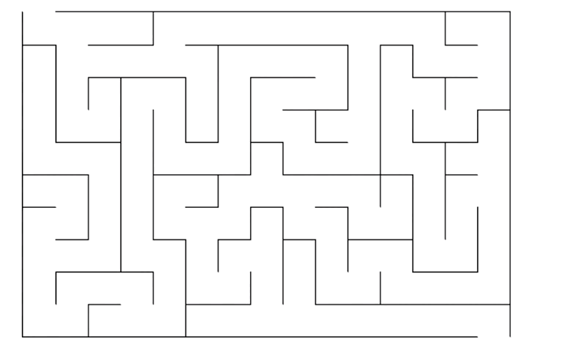

Introduction -- Quantum Mechanics (QM)

Slide 17
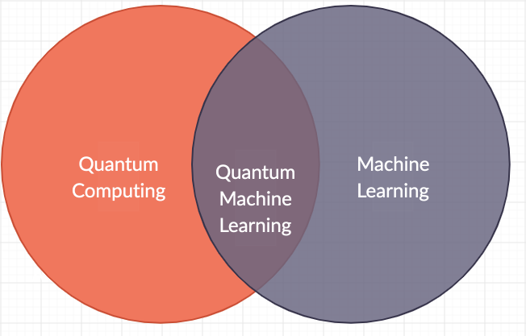
Quantum Machine Learning (QML)

Slide 18
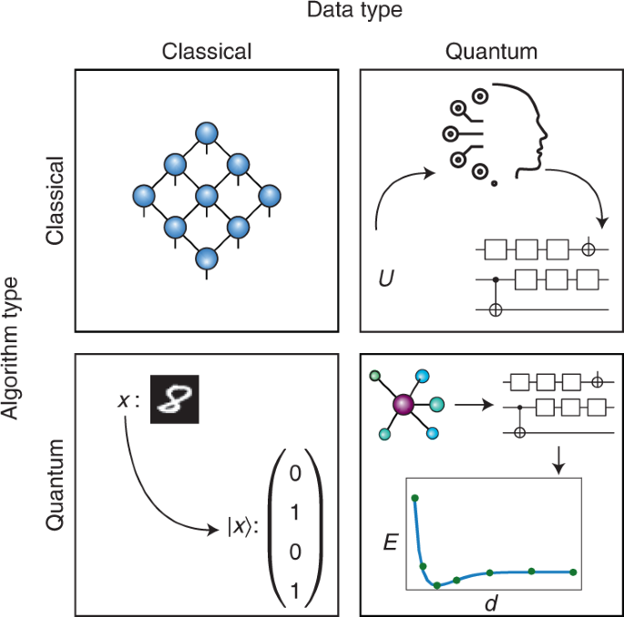
Quantum Machine Learning (QML) tasks
Quantum machine learning is usually considered for four main tasks. These include tasks where the data is either classical or quantum, and where the algorithm is either classical or quantum. Top left: tensor networks are quantum-inspired classical methods that can analyze classical data. Top right: unitary time-evolution data U from a quantum system can be classically compiled into a quantum circuit. Bottom left: handwritten digits can be mapped to quantum states for classification on a quantum computer. Bottom right: molecular ground state data can be classified directly on a quantum computer. The figure shows ground state energy E dependence on the distance d between the atoms.

Slide 19
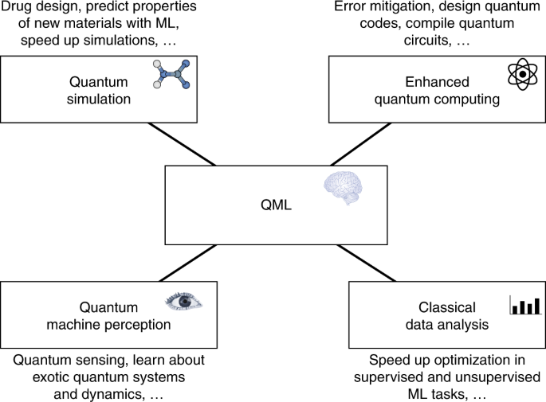
QML Applications
QML has been envisioned to bring a computational advantage in many applications. QML can enhance quantum simulation for chemistry (e.g., molecular ground states, equilibrium states and time evolution) and materials science (e.g., quantum phase recognition and generative design with a target property in mind ). QML can enhance quantum computing by learning quantum error correction codes and syndrome decoders, performing quantum control, learning to mitigate errors, and compiling and optimizing quantum circuits. QML can enhance sensing and metrology and extract hidden parameters from quantum systems. Finally, QML may speed up classical data analysis, including clustering and classification. Some applications produces data that is inherently quantum mechanical.

Slide 20
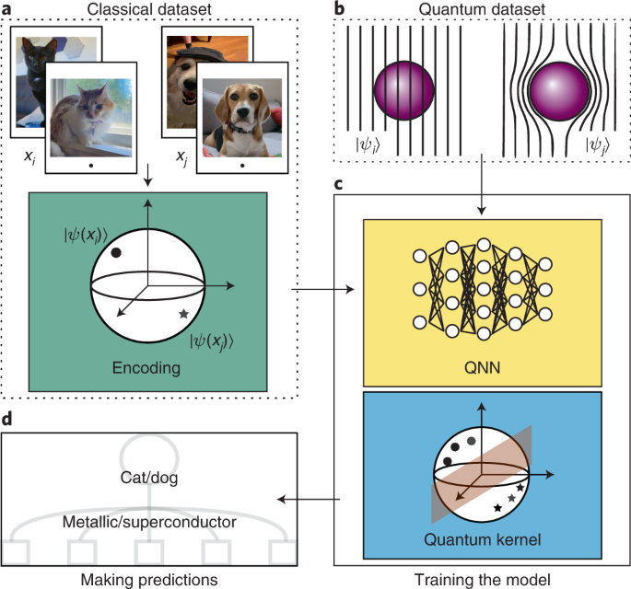
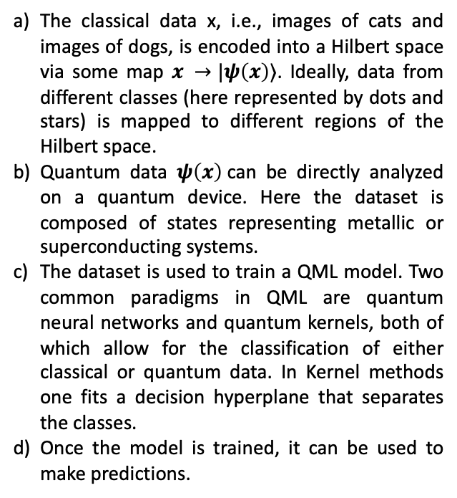
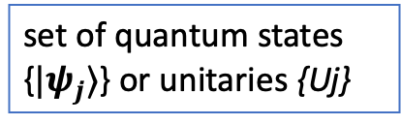
Data in QML
set of quantum states {$|ψ_{j}⟩$} or unitaries {Uj}
The classical data x, i.e., images of cats and images of dogs, is encoded into a Hilbert space via some map $x →|ψ\left(x\right)⟩$. Ideally, data from different classes (here represented by dots and stars) is mapped to different regions of the Hilbert space.
Quantum data $ψ\left(x\right)$can be directly analyzed on a quantum device. Here the dataset is composed of states representing metallic or superconducting systems.
The dataset is used to train a QML model. Two common paradigms in QML are quantum neural networks and quantum kernels, both of which allow for the classification of either classical or quantum data. In Kernel methods one fits a decision hyperplane that separates the classes.
Once the model is trained, it can be used to make predictions.

Slide 21
QML Algorithms
Quantum-inspired algorithms [1-6]
simulated quantum annealing to optimize classical cost functions
Do not require a quantum computer
Quantum data processing algorithms
Exploiting the quantum properties of data for CML
Quantum-enhanced classical machine learning algorithms
CML uses quantum features for improvement
Variational quantum algorithms [8,9]
Use variational methods to optimize a cost function on a quantum computer
VQA (QNN) solve ML problem on a quantum computer using PQC.
Quantum clustering algorithms [7]
cluster data using quantum methods
Qk-means uses the phase estimation algorithm to cluster data points into k groups.
Quantum kernel [10,11]
Quantum Reinforcement Learning

Slide 22
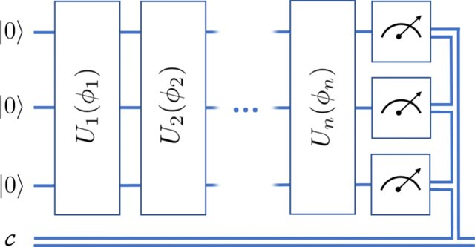
Quantum Neural Networks (QNN)
sequence of unitary gates acting on the quantum data states
General parameterized quantum circuit, with arbitrary unitaries U, input state |0〉, and classical register c, where ϕ = [ϕ1,ϕ2,...,ϕn] are the parameters of the circuit. Though the unitaries do not necessarily act on all qubits, we have arranged them here in “blocks,” similar to the general architectures of VQE where a block of operations may be repeated many times in a circuit, with different parameters. In the case of VQE, a block might be a series of single-qubit rotations or a set of entangling gates (such as CNOT), or block might be a phase unitary encoding the cost function or a mixing unitary for searching the solution space.

Slide 23
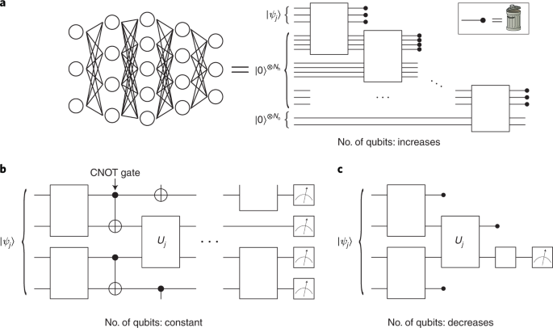
Examples of QNN architectures
a) Dissipative QNN -- classical feed-forward network, nodes are qubits, and lines connecting them are unitary operations. Term dissipative arises from the fact that qubits in a layer are discarded after the information forward-propagates to the (new) qubits in the next layer.
b) Standard QNN -- quantum data states are sent through a quantum circuit, at the end of which some or all of the qubits are measured. Here, no
qubits are discarded or added as one goes deeper into the QNN.
c) Convolutional QNN -- each layer qubits are measured to reduce the dimension of the data while preserving its relevant features.

Slide 24
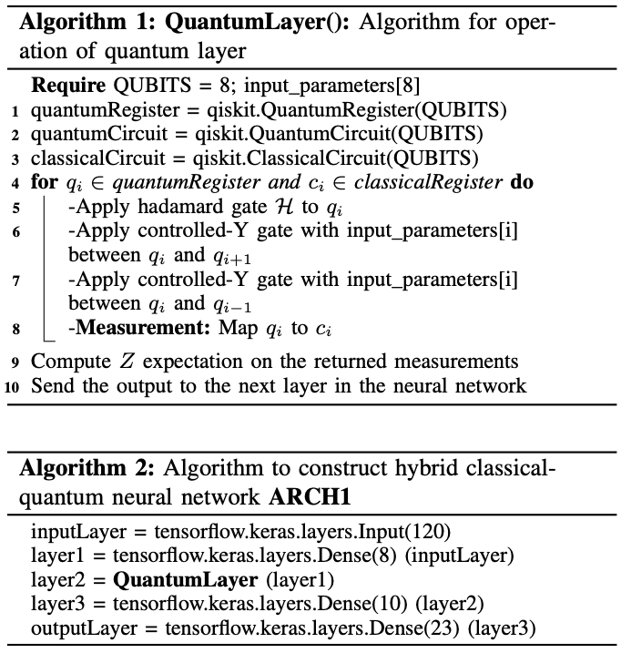
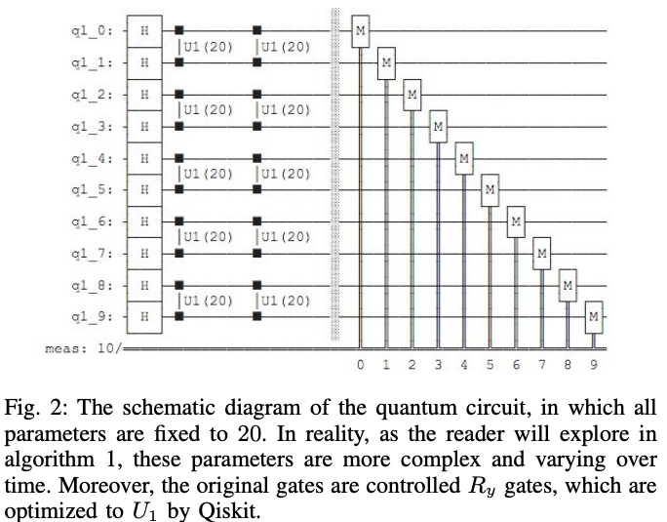
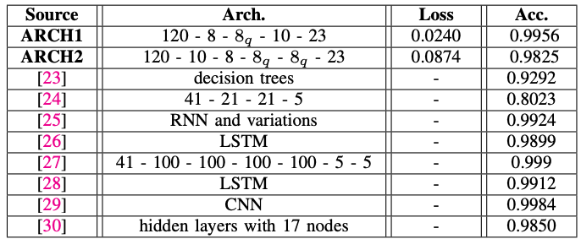
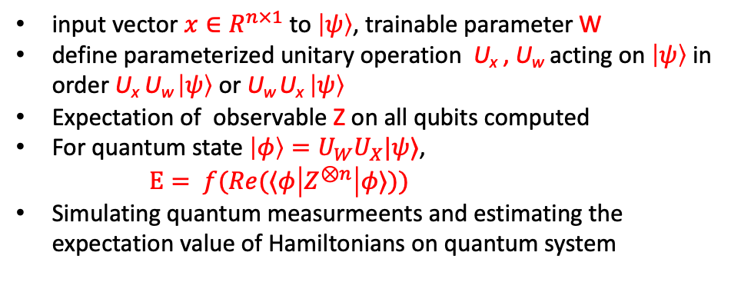
Hybrid Quantum Neural Networks (QNN)
input vector $x∈R^{n×1}$ to $|ψ〉$, trainable parameter W
define parameterized unitary operation U_{x} , U_{w} acting on $|ψ〉$ in order U_{x} U_{w} $|ψ〉$ or U_{w} U_{x} $|ψ〉$
Expectation of observable Z on all qubits computed
For quantum state $\left|φ\right\rangle =U_{W}U_{X}|ψ⟩$,
$E= f(Re(⟨φ\left|Z^{⊗n}\right|φ⟩))$
Simulating quantum measurmeents and estimating the expectation value of Hamiltonians on quantum system

Slide 25
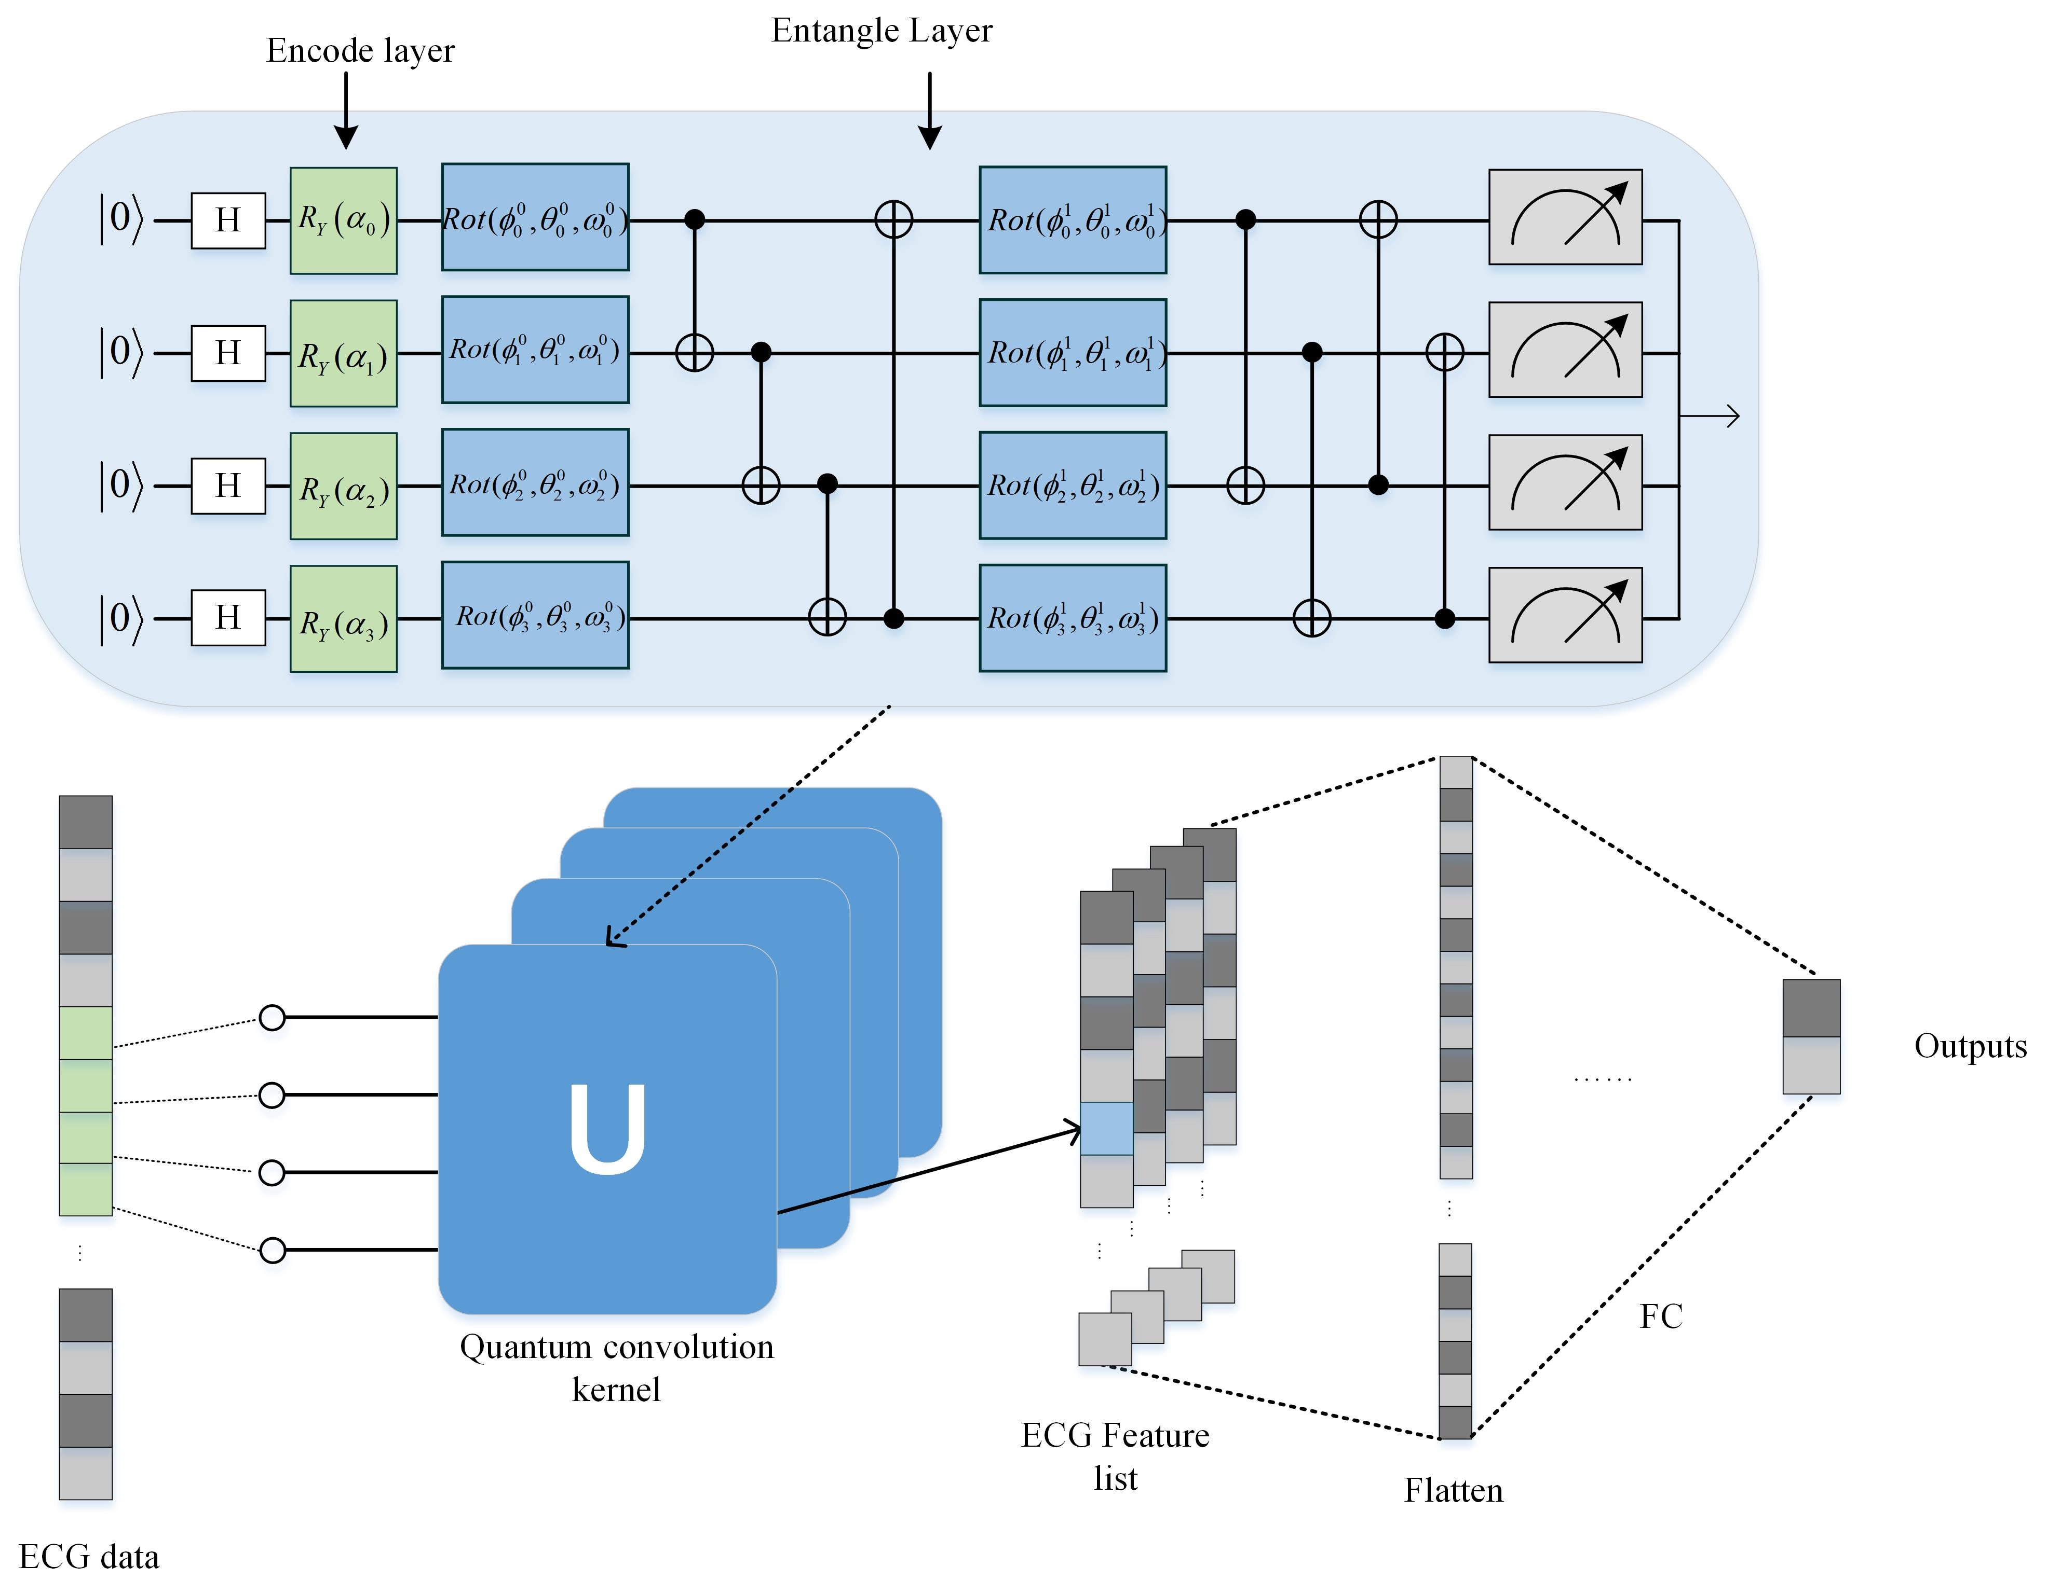
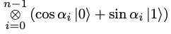



Hybrid Quantum Neural Networks (QNN)
quantum encoding for each convolution,
$U_{E}:x∈ R→ \left|φ\left(x\right)\right\rangle =$
entanglement circuit in the quantum convolution kernel uses the Rot gate.
By adjusting the appropriate parameters, Rot gate can rotate state $|0⟩$ to any positions on the Bloch Sphere.
Correlation measurement expectation $⟨φ\left|U^{\begin{aligned} \\ †\end{aligned}}Z^{⊗n}U\right|φ⟩$ is used as the output of the quantum circuit, because it express the entanglement information of the quantum circuit.
The convolutional layer is replaced by parameterized quantum circuits, and the linear layer is composed of classical fully connected neural networks.

Slide 26

Quantum Kernels

Slide 27



Quantum Kernels
Fidelity circuit

Slide 28

Challenges in QML
a) There are several ingredients and priors needed to build a QML model: a dataset (and an encoding scheme for classical data), the choice of parameterized model, loss function, and classical optimizer. In this diagram, we show some of the challenges of the different components of the model.
b-d) The success of the QML model hinges on an accurate and efficient training of the parameters.
However, there are certain phenomena that can hinder QML trainability. These include the abundance of low-quality local minima solutions shown in b), as well as the barren plateau phenomenon in c). When a QML architecture exhibits a barren plateau, the landscape becomes exponentially flat (on average) as the number of qubits increases (seen as a transition from dashed to solid line). The presence of hardware noise has been shown to erase the features in the landscape as well as potentially shift the position of the minima. Here, the dashed (solid) line corresponds to the noiseless (noisy) landscape shown in d).

Slide 29
Quantum Resources
Qiskit (https://qiskit.org/ecosystem/machine-learning/index.html)
Pennylane (https://pennylane.ai/)
myQLM (https://atos.net/en/lp/myqlm)
IBM Quantum systems (https://www.ibm.com/quantum/qiskit-runtime) --quantum system with 7-qubit, 5-qubit QPUs, 27-qubit Falcon systems, 127-qubit Eagle systems, or simulators.
…….

Slide 30
References
Tiwari, P., & Melucci, M. (2018, October). Towards a quantum-inspired framework for binary classification. In Proceedings of the 27th ACM international conference on information and knowledge management.
Tiwari, P., & Melucci, M. (2019, July). Binary classifier inspired by quantum theory. In Proceedings of the AAAI conference on artificial intelligence.
Zhang, Y., Liu, Y., Li, Q., Tiwari, P., Wang, B., Li, Y., ... & Song, D. (2021). CFN: a complex-valued fuzzy network for sarcasm detection in conversations. IEEE Transactions on Fuzzy Systems.
Li, Q., Melucci, M., & Tiwari, P. (2018, September). Quantum language model-based query expansion. In Proceedings of the 2018 ACM SIGIR International Conference on Theory of Information Retrieval.
Moreira, C., Tiwari, P., Pandey, H. M., Bruza, P., & Wichert, A. (2020). Quantum-like influence diagrams for decision-making. Neural Networks, 132, 190-210.
Uprety, S., Tiwari, P., Dehdashti, S., Fell, L., Song, D., Bruza, P., & Melucci, M. (2020). Quantum-like structure in multidimensional relevance judgements. In Advances in Information Retrieval: 42nd European Conference on IR Research, ECIR 2020, Lisbon, Portugal, April 14–17, 2020, Proceedings, Part I 42 (pp. 728-742). Springer International Publishing.
Deshmukh, Shradha, et al. "Explainable quantum clustering method to model medical data." Knowledge-Based Systems 267 (2023): 110413.
Beer, Kerstin, et al. "Training deep quantum neural networks." Nature communications 11.1 (2020): 808.
Laxminarayana, Nikhil, et al. "Quantum-assisted activation for supervised learning in healthcare-based intrusion detection systems." IEEE Transactions on Artificial Intelligence (2022).
Tiwari, Prayag, et al. "Kernel method based on non-linear coherent states in quantum feature space." Journal of Physics A: Mathematical and Theoretical 55.35 (2022): 355301.
Wang, Xinbiao, et al. "Towards understanding the power of quantum kernels in the NISQ era." Quantum 5 (2021): 531.

Slide 31
Thank You!

